Slide 1

Ray
August 2022

Slide 2
Table of Contents
Architecture
Object and Object Store
Memory Management
Resource Management
Scheduling

Slide 3
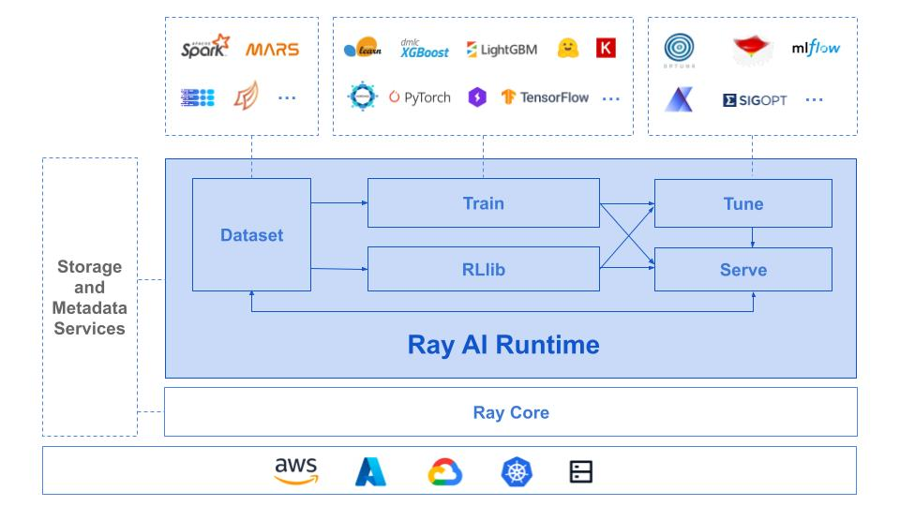
Ray: A Distributed ML Framework [1,2]
Architecture
Object
Memory
Resource
Scheduling
A distributed execution framework for emerging AI applications
Apps and libraries
Ray
Cloud service providers
[1] https://www.usenix.org/conference/osdi18/presentation/moritz
[2] https://docs.google.com/document/d/1lAy0Owi-vPz2jEqBSaHNQcy2IBSDEHyXNOQZlGuj93c/preview

Slide 4
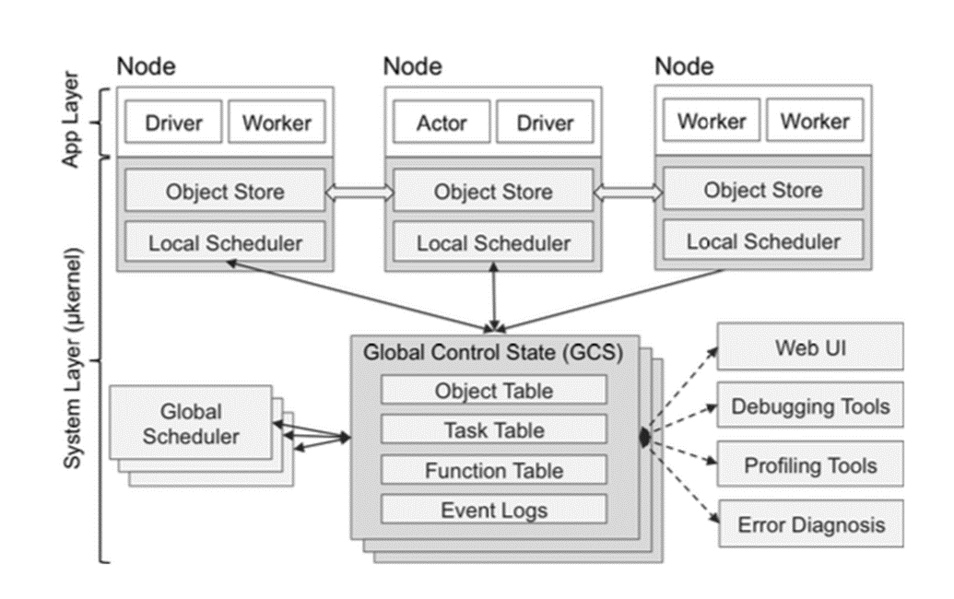
Ray: Architecture
Architecture
Object
Memory
Resource
Scheduling
Ray’s architecture consists of two parts: an application layer and a system layer.
Application layer:
Worker: a stateless process that serially executes tasks (remote functions) invoked by a driver or another worker. Workers are started automatically and assigned tasks by the system layer. When a remote function is declared, the function is automatically published to all workers.
Driver: a special worker process that executes the top-level application. It can submit tasks, but cannot execute any itself. Driver processes can run on any node.
Actor: a stateful process that serially executes, when invoked, the methods it exposes. Unlike a worker, an actor is explicitly instantiated by a worker or a driver.
Global Control Store (GCS)

Slide 5
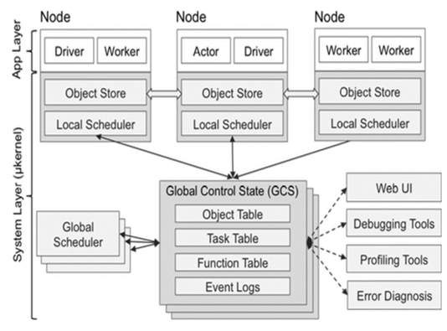
Ray: Architecture
Architecture
Object
Memory
Resource
Scheduling
Worker
a stateless process that serially executes tasks (remote functions) invoked by a driver or another worker. When a remote function is declared, the function is automatically published to all workers.
started automatically and assigned tasks by the system layer.
Driver: a special worker process that executes the top-level application. It can submit tasks, but cannot execute any itself. Driver processes can run on any node.
Actor: a stateful process that serially executes, when invoked, the methods it exposes. Unlike a worker, an actor is explicitly instantiated by a worker or a driver.
Global Control Store (GCS)

Slide 6
Ray: Architecture
Architecture
Object
Memory
Resource
Scheduling
Worker
a stateless process that serially executes tasks (remote functions) invoked by a driver or another worker. When a remote function is declared, the function is automatically published to all workers.
started automatically and assigned tasks by the system layer.
Driver
a special worker process that executes the top-level application.
It can submit tasks but cannot execute any itself.
Driver processes can run on any node.
Actor: a stateful process that serially executes, when invoked, the methods it exposes. Unlike a worker, an actor is explicitly instantiated by a worker or a driver.
Global Control Store (GCS)

Slide 7
Ray: Architecture
Architecture
Object
Memory
Resource
Scheduling
Worker
a stateless process that serially executes tasks (remote functions) invoked by a driver or another worker. When a remote function is declared, the function is automatically published to all workers.
started automatically and assigned tasks by the system layer.
Driver
a special worker process that executes the top-level application.
It can submit tasks but cannot execute any itself.
Driver processes can run on any node.
Actor
a stateful process that serially executes the methods it exposes. Unlike a worker, an actor is explicitly instantiated by a worker or a driver.
Global Control Store (GCS)

Slide 8

Ray: Architecture
Architecture
Object
Memory
Resource
Scheduling
The System Layer consists of three major components: a global control store, a distributed scheduler, and a distributed object store. More details in slides later.
• Task - A single function invocation that executes on a process different from the caller. A task is executed asynchronously with the caller.
• Object - An application value. This may be returned by a task or created through `ray.put`. Objects are immutable: they cannot be modified once created. A worker can refer to an object using an `ObjectRef`.
• Job - The collection of tasks, objects, and actors originating (recursively) from the same driver.
Global Control Store (GCS)

Slide 9
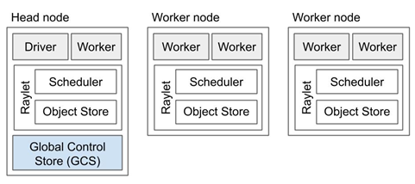
Ray: Architecture
Architecture
Object
Memory
Resource
Scheduling
A Ray cluster comprises a set of worker nodes and a centralized Global Control Store (GCS) instance.
Each worker node has:
1. One or more work processes, responsible for task submission and execution. Each is associated with a specific job. The default number of initial workers is equal to the number of CPUs on the machine.
2. A raylet. The raylet is shared among all jobs on the same cluster. The raylet has two main components, run on separate threads:
1). A scheduler. Responsible for resource management and fulfilling task arguments that are stored in the distributed object store. The individual schedulers in a cluster comprise the Ray distributed scheduler.
2). A shared-memory object store (also known as the Plasma Object Store). Responsible for storing and transferring large objects. The individual object stores in a cluster comprise the Ray distributed object store.
Each worker stores:
1). An ownership table. System metadata for the objects to which the worker has a reference, e.g., to store ref counts and object locations.
2). An in-process store, used to store small objects.

Slide 10
Ray: Architecture
Architecture
Object
Memory
Resource
Scheduling
Each worker node has:
1. One or more work processes, responsible for task submission and execution. Each is associated with a specific job. The default number of initial workers is equal to the number of CPUs on the machine.
Each worker stores:
1). An ownership table. System metadata for the objects to which the worker has a reference, e.g., to store ref counts and object locations.
2). An in-process store, used to store small objects.
One of the worker nodes is designated as the head node. In addition to the processes a worker load has, the head node also hosts:
The Global Control Store (GCS).
The driver process(es).

Slide 11
Ray: Architecture
Architecture
Object
Memory
Resource
Scheduling
Each worker node has:
One or more work processes, responsible for task submission and execution. Each is associated with a specific job. The default number of initial workers is equal to the number of CPUs on the machine.
2. A raylet. The raylet is shared among all jobs on the same cluster. The raylet has two main components, run on separate threads:
1). A scheduler. Responsible for resource management and fulfilling task arguments that are stored in the distributed object store. The individual schedulers in a cluster comprise the Ray distributed scheduler.
2). A shared-memory object store (also known as the Plasma Object Store). Responsible for storing and transferring large objects. The individual object stores in a cluster comprise the Ray distributed object store.
One of the worker nodes is designated as the head node. In addition to the processes a worker load has, the head node also hosts:
The Global Control Store (GCS).
The driver process(es).

Slide 12
Ray: Architecture
Architecture
Object
Memory
Resource
Scheduling
Each worker node has:
One or more work processes, responsible for task submission and execution. Each is associated with a specific job. The default number of initial workers is equal to the number of CPUs on the machine.
2. A raylet. The raylet is shared among all jobs on the same cluster. The raylet has two main components, run on separate threads:
1). A scheduler. Responsible for resource management and fulfilling task arguments that are stored in the distributed object store. The individual schedulers in a cluster comprise the Ray distributed scheduler.
2). A shared-memory object store (also known as the Plasma Object Store). Responsible for storing and transferring large objects. The individual object stores in a cluster comprise the Ray distributed object store.
One of the worker nodes is designated as the head node. In addition to the processes a worker load has, the head node also hosts:
The Global Control Store (GCS).
The driver process(es).

Slide 13
Ray: Architecture Summary
Architecture
Object
Memory
Resource
Scheduling
Design for distributed computing from the standpoint of a user.
Scenario and application: a user have access to multiple resources in cloud services (AWS, Azure, Google, etc.) and want to run different ML applications (TensorFlow, PyTorch, etc.) across these resources.
Note: App Layer in the Ray architecture is not for a layer of specific applications (Spark, PyTorch, etc.)
Distributed parallel execution: Actors, drivers, and workers run locally.
Distributed memory: Object store of each node has the capability to share memory with other nodes.
Distributed scheduler: local schedulers communicate with global schedulers and GCS for resource management and computation.
Global Control Store (GCS)

Slide 14
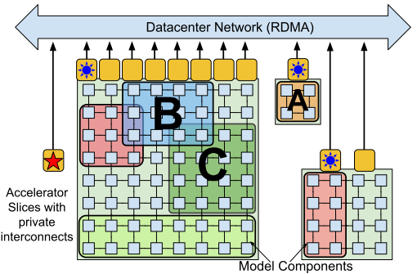
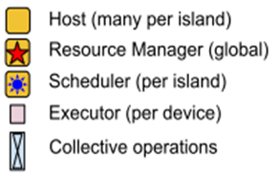
Ray: Architecture Comparison
Architecture
Object
Memory
Resource
Scheduling
Ray: Design for user
Pathway: Design for data center
Global Control Store (GCS)
Only have access to certain resources
Resource Manager: have access to all resources

Slide 15
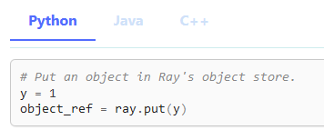
Ray: Object [3]
Architecture
Object
Memory
Resource
Scheduling
Object: an application value.
Example
Object
Object ref (as in reference)
[3] https://docs.ray.io/en/master/ray-core/objects.html

Slide 16
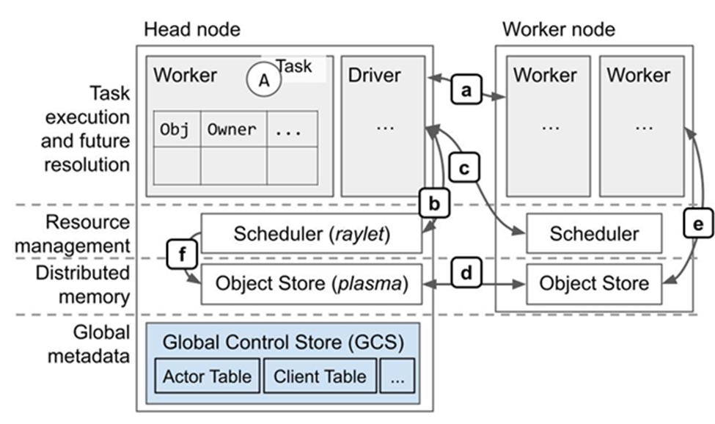
Ray: Object Store
Architecture
Object
Memory
Resource
Scheduling
Tasks and actors create and compute on objects (or remote objects), which can be stored anywhere in a Ray cluster, and referred by object refs. Remote objects are cached in Ray’s distributed shared-memory object store
One object store per node in the cluster.
Ray makes it simpler for an application to leverage parallel and distributed execution and distributed memory sharing (via a shared memory object store).
The use of distributed memory allows a process to reference an object without having the object local, so a process can reference objects whose total size exceeds the memory capacity of a single machine.

Slide 17
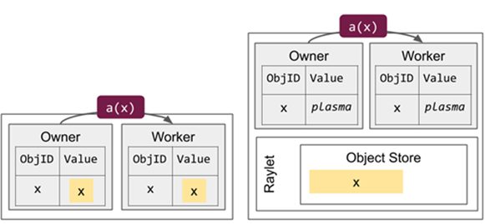
Ray: Small Object Management
Architecture
Object
Memory
Resource
Scheduling
Small objects (default threshold is 100KB) are resolved by copying them directly from the owner’s in-process store.
The value of an object can be resolved using an `ObjectRef`. The `ObjectRef` comprises two fields:
A unique 20-byte identifier, including a concatenation of the ID of the task that produced the object and the integer number of objects created by that task so far.
The address of the object’s owner (a worker process), including the worker process’s unique ID, IP address and port, and local raylet’s unique ID.
Small objects are local to the owner process: if a borrower attempts to resolve the value, the object is promoted to shared memory, where it can be retrieved through the distributed object resolution protocol.
Large objects are stored in the distributed object store.
Small objects are stored in their owner’s in-process store.
For example, if the owner calls `ray.get`, the system looks up and deserializes the value from the local in-process store. If the owner submits a dependent task, it inlines the object by copying the value directly into the task description.

Slide 18
Ray: Small Object Management
Architecture
Object
Memory
Resource
Scheduling
Small objects (default threshold is 100KB) are resolved by copying them directly from the owner’s in-process store.
The value of an object can be resolved using an `ObjectRef`. The `ObjectRef` comprises two fields:
A unique 20-byte identifier, including a concatenation of the ID of the task that produced the object and the integer number of objects created by that task so far.
The address of the object’s owner (a worker process), including the worker process’s unique ID, IP address and port, and local raylet’s unique ID.
Small objects are local to the owner process: if a borrower attempts to resolve the value, the object is promoted to shared memory, where it can be retrieved through the distributed object resolution protocol.
Large objects are stored in the distributed object store.
Small objects are stored in their owner’s in-process store.
For example, if the owner calls `ray.get`, the system looks up and deserializes the value from the local in-process store. If the owner submits a dependent task, it inlines the object by copying the value directly into the task description.

Slide 19
Ray: Large Object Management
Architecture
Object
Memory
Resource
Scheduling
Large objects are stored in the distributed object store.
Large objects must be resolved with a distributed protocol.
Multiple workers on the same node can reference the same copy of an object.
Object is already stored in the reference holder’s local shared memory store:
Reference holder retrieves the object over IPC.
Return a pointer to shared memory that may be simultaneously referenced by other workers on the same node.
Object is NOT available in the local shared memory store:
Reference holder notifies its local raylet and attempts to fetch a copy from a remote raylet.
The raylet looks up the locations from the object directory and requests a transfer from one of these raylets.
Example: The object x is initially created on Node 2. When the owner (the caller of the task) calls `ray.get`:
Lookup object’s locations at the owner.
Select a location and send a request for a copy of the object.
Receive the object.

Slide 20
Ray: Large Object Management
Architecture
Object
Memory
Resource
Scheduling
Large objects are stored in the distributed object store.
Large objects must be resolved with a distributed protocol.
Multiple workers on the same node can reference the same copy of an object.
Object is already stored in the reference holder’s local shared memory store:
Reference holder retrieves the object over IPC.
Return a pointer to shared memory that may be simultaneously referenced by other workers on the same node.
Object is NOT available in the local shared memory store:
Reference holder notifies its local raylet and attempts to fetch a copy from a remote raylet.
The raylet looks up the locations from the object directory and requests a transfer from one of these raylets.
Example: The object x is initially created on Node 2. When the owner (the caller of the task) calls `ray.get`:
Lookup object’s locations at the owner.
Select a location and send a request for a copy of the object.
Receive the object.

Slide 21
Ray: Object Loss
Architecture
Object
Memory
Resource
Scheduling
Small objects that are stored in the in-process object store fate-share with their owner.
Object is lost from distributed memory
Non-primary copies* of an object can be lost without consequences.
If the primary copy of an object is lost, the owner will attempt to designate a new primary copy by looking up the remaining locations in the object directory. If none exist, the owner stores a system-level error that will be thrown during object resolution.
Object reconstruction
Recovery of a lost object through re-execution of the task that created the object.
Owner caches the object lineage: the descriptions of the tasks needed to recreate an object in memory.
If all object copies are lost due to a failure, the owner resubmits the task that returned the object. Any objects that the task depends on are recursively reconstructed.
Reconstruction not support objects created with `ray.put`, because the primary copy for these objects is always the owner’s local shared memory store. Thus, the primary copy cannot be lost independently of the owner process (fate-share protocol).
* First copy is usually a primary copy, refer to Memory Management.

Slide 22
Ray: Object Summary
Architecture
Object
Memory
Resource
Scheduling
Object: an application value.
Objects are put in object store.
Distributed computation efficiency and memory efficiency.
Small objects are stored in owner’s in-process store, which reduces object dependency and increase computation speed
Large objects are shared through distribute protocol, which reduces the number of object copies and memory usage.
Large objects are stored in the distributed object store.
Small objects (<100KB) are stored in their owner’s in-process store.
Fate-share with their owner; if other workers need them, they will be copied directly from the owner’s in-process store.
Large objects must be resolved with a distributed protocol; multiple workers on the same node can reference the same copy of an object.
[3] https://docs.ray.io/en/master/ray-core/objects.html

